Slide 1

ESHIP 106
Entrepreneurship Venture Launch
Instructor: Joe Henderson, MBA
Classroom: 2801, Maggini Hall
Office: Business Department Front Room
Office hours: By Appointment
jhenderson2@santarosa.edu – preferred Canvas Email
Cell: 707.292.2869 (personal cell)

Slide 2

Education
B.S. Communications, University of Utah
M.B.A. Entrepreneurship, University of San Francisco
A.A. Kingston Educational Center, Kingston, England
Teaching Experience
Starting 10th year teaching at SRJC
Certified Trainer/Consultant for Microsoft Corporation
Industry Experience – 34 years of business experience
24 years: Broker/Owner – Heritage Realty and Mortgage Loan Officer
Business Created
Introduction

Slide 3
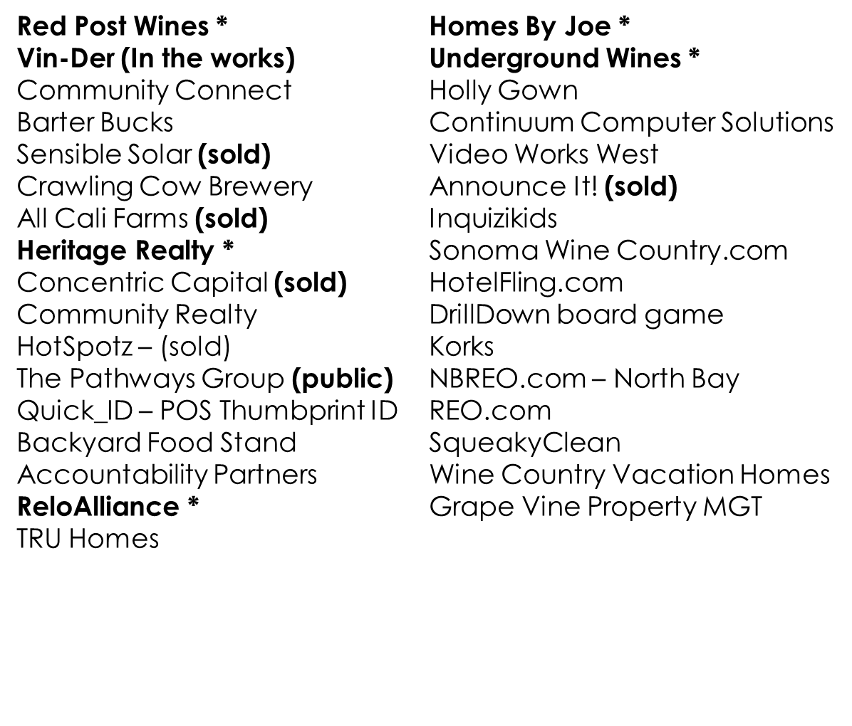
Joe’s Startup – Biz Dev (35 years)
* = still active

Slide 4
Preparation for Class
One – learn the foundation – then apply to your idea/concept
Two – Take your existing idea and apply each of the areas learned into developing your idea

Slide 5
Three Types of Students
Not interested in launching an idea or business
Has an idea they want to get off the ground
Wants to learn as much as possible to apply towards an idea they may not yet have

Slide 6
The Final Launch
By the end of the semester, you’ll have your business ready to take to the next level
Launch
Fundraising
Road Map

Slide 7
Semester Deliverables
Executive Summary
Montra/Tag
Mission Statement
Fill out Business Plan Workbook
Understand and Complete: The Business Model Canvas – 9 Building Blocks
Complete Business Plan
Complete Flip Deck
Complete Financials

Slide 8
Why We Are Here
Major corporations - typically drive job growth, but have been stagnant
Trends in AI, machine learning and robotics – reduce Human Resources
startups and small-medium sized businesses account for 99% of businesses in the United States

Slide 9
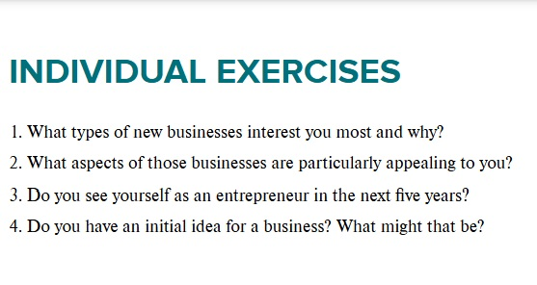
What do YOU want?

Slide 10
Explain the Entrepreneur
What Is an Entrepreneur?
An entrepreneur is an individual who creates a new business, bearing most of the risks and enjoying most of the rewards. The entrepreneur is commonly seen as an innovator, a source of new ideas, goods, services, and business/or procedures.
Entrepreneurs play a key role in any economy, using the skills and initiative necessary to anticipate needs and bring good new ideas to market. Entrepreneurs who prove to be successful in taking on the risks of a startup are rewarded with profits, fame, and continued growth opportunities. Those who fail, suffer losses and become less prevalent in the markets.

Slide 11
90% of Start-ups Fail
Don’t get discouraged
Not easy, or everyone would be doing it
An idea is only as valuable as the napkin it was written on!
Execution is Key
Unless you are: Rollin King and Herb Kelleher from Southwest Airlines

Slide 12
Famous Entrepreneurs
https://www.youtube.com/watch?v=chTqhrLNI3c
Notes:
What is an entrepreneur? Who do you think of when we say the word? What makes them different?

Slide 13
Understand the Term & Role
Entrepreneur
Doesn’t have to be a global name for success
Can be local
Can be unknown to the majority consumer

Slide 14
Research and Resources
Learn all you can!
https://www.entrepreneur.com/
https://www.purdueglobal.edu/blog/business/entrepreneur-resources/
https://www.score.org/
https://www.sba.gov/local-assistance
https://otd.harvard.edu/faculty-inventors/resources/resources-for-entrepreneurs/

Slide 15
Suggestions to get started NOW
https://en.wikipedia.org/wiki/Traf-O-Data
Notes:
1971 two teenagers from Lake Side School, both 15 and 18 years old. They started a business called: Traft-o-Data, it had nominal success, but after only a year, the company folded after losing $4,000. ($32,000 today) Who were these guys? Bill Gates and Paul Allen

Slide 16
Tony Hsieh, Entrepreneur
Sold to Amazon for $1.2 Billion
$850 M in net worth
Interview with Tony, CEO of Zappos
Interview with Tony, after sale of Zappos to Amazon
The Life Cycle of Zappos, and Tony Hsieh CEO
Notes:
Tony passed away in 2020, leaving behind a legacy – regentrified downtown Las Vegas

Slide 17
Start-up Stats
69 percent of U.S. entrepreneurs start their businesses at home.
Gender:
  73 percent identify as male; and
  25 percent identify as female.

Slide 18
Age Range
  50-59 years old: 35 percent;
  40-49 years old: 25 percent;
  60-69 years old: 18 percent;
  30-39 years old: 14 percent;
  18-29 years old: 4 percent; and
  70+ years old: 4 percent.

Slide 19
Education
  High School / GED: 33 percent;
  Associates Degree: 18 percent;
  Bachelor’s Degree: 29 percent;
  Master’s Degree: 16 percent; and
  Doctorate: 4 percent.

Slide 20
Top 10 causes of small business failure
  No market need: 42 percent;
  Ran out of cash: 29 percent;
  Not the right team: 23 percent;
  Got outcompeted: 19 percent;
  Pricing / Cost issues: 18 percent;
  User un-friendly product: 17 percent;
  Product without a business model: 17 percent;
  Poor marketing: 14 percent;
  Ignore customers: 14 percent; and
  Product mistimed: 13 percent.

Slide 21
Reason for Starting Business:
  Ready to be his/her own boss: 26 percent;
  Wanted to pursue his/her passion: 23 percent;
  The opportunity presented itself: 19 percent;
  Dissatisfied with corporate America: 12 percent;
  Laid off or outsourced: 6 percent;
  Not ready to retire: 6 percent;
  Other: 5 percent;
  Life event such as divorce, death, etc.: 3 percent.

Slide 22
Success Rate
  80 percent made it to the second year (2015);
  70 percent made it to the third year (2016);
  62 percent made it to the fourth year (2017);
  56 percent made it to the fifth year (2018).

Slide 23
What can we do to Improve Success?
Prepare - Do your homework
Find the customer
Solve the problem
Be willing to make changes
Spend money wisely
Find the right team
Don’t give up
Educating yourself in the environment you wish to develop your start into, will allow you to reduce your risk. Stay on top of your market always.

Slide 24
Innovation – Not always Invention
  As we have seen over and over again, legacy industries are not the ones to lead the quantum leaps the broader society needs them to.
    Taxi drivers did not invent Uber. / Hilton had no part in AirBnB
    Wells Fargo had no role in PayPal, VenMo or Bitcoin
    GM/Ford had no part of Tesla / Chevron/Shell does not do solar R&D
    Government does not beta-test liquid democracy, mobile voting or other governance practices.

Slide 25
Driving Opportunity
  As a global community, we are at a pivotal point in time. We have more tools, resources, skills, connections and abilities than ever before, and the challenges we face are massive. What are some challenges we face as a society?
    Climate change
    Violence
    Economic disparities
    Failing infrastructure
    Health (physical and mental)
    Security (policing, cyber, etc.)
    Inflexible governance structures

Slide 26
Business Plan – VS – Pitch Deck
Explain Each
Benefits of each
Why some say no to Business Plans

Slide 27
The Startup Owner’s Manual
Steve Blank’s Approach
Scientist/Engineer – Focused on solving the problem
Big on models
Test and prove through identify the “hypotheses”
Refine – Test – Prove
Search of a repeatable, scalable, and profitable business model

Slide 28
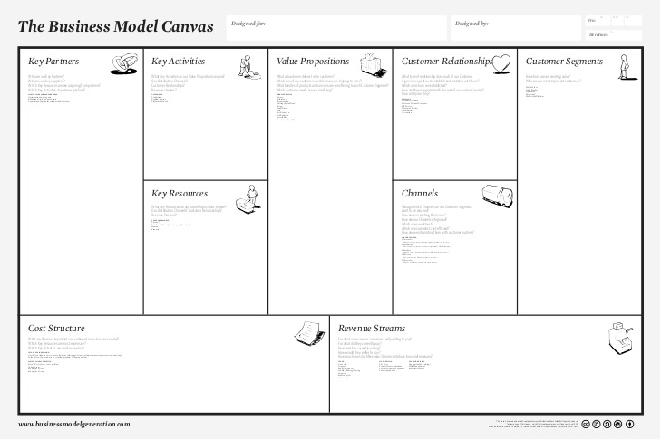
Business Model Canvas

Slide 29
Napa Valley College
Business Plan Workbook
Will provide to class – use as a template to create a usable business plan
Work in progress
Needs to change as you change
Great guide, but don’t get lost in process

